Slide 1

Lesson 10-1
Post Correspondence Problem
Theory of Computation
王轩
Wang Xuan

Slide 2



Dominos and Match
Domino, containing two strings on each side
Collection of dominos
Match: make a list of these dominos (repetitions permitted) so that the symbols on the top is same as the symbol on the bottom.
An example
symbols: abcaaabc

Slide 3


Example
Deform the dominos so that corresponding symbols from top and bottom line up.
For some collections of dominos, there is no match. For example

Slide 4

Post Correspondence Problem
PCP is to determine whether a collection of dominos has a match. It’s unsolvable by algorithms.
  Formally, an instance of the PCP is a collection P of dominos:
  and a match is a sequence i₁, i₂, …, i_{l}, where t_{i1}t_{i2}…t_{il} = b_{i1}b_{i2}…b_{il}. The problem is to determine whether P has a match.
PCP = {<P>|P is an instance of the Post correspondence problem with a match }

Slide 5
PCP is undecidable
Idea: Reduction from A_{TM} via accepting computation histories
From any TM M and input w, construct an instance P where a match is an accepting computation history for M on w.
  If we could determine whether the instance has a match, we would be able to determine whether M accepts w.

Slide 6


How to construct P
Choose the dominos in P so that making a match forces a simulation of M to occur.
  Each domino links a position in one configuration with the corresponding one in the next configuration.
Modify PCP to require that a match starts with the first domino,
Modified Post Corresponding Problem (MPCP)
  MPCP={<P>|P is an instance of the Post correspondence problem with a match that starts with the first domino}

Slide 7
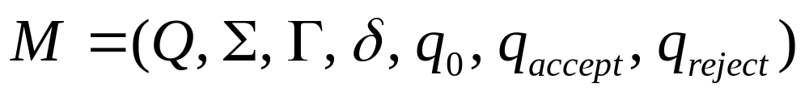
Proof
Let TM R decide the PCP and construct S deciding A_{TM}. Let
S construct an instance of PCP p that has a match iff M accepts w. We first construct an instance P’ of MPCP.
There are 7 parts, each of which accomplishes a particular aspect of simulating M on w.

Slide 8


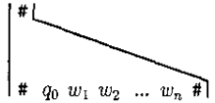
Part 1
The construction begins as
Put into P’ as the first domino .
The bottom string begins correctly with C1=q₀w₁w₂…w_{n,} the first configuration in the accepting computation history for M on w.

Slide 9
Extending the top string to match the bottom string, we provide additional dominos to allow this extension.
  Part2 handles head motions to the right
  Part3 handles head motions to the left
  Part4 handles the tape cells not adjacent to the head
These additional dominos cause M’s next configuration to appear at the extension of the bottom by forcing a single-step simulation of M.

Slide 10



Part 2,3,4

Slide 11

Part 5
The first marks the separation of the configurations
The second add a blank symbol at the end of the configuration to simulate the infinitely many blanks.

Slide 12

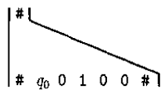

An example
Let Γ={0,1,2, }.
w is the string 0100, and the start state of M is q₀.
δ(q₀,0)=(q₇,2,R)
Part 1 place the domino in P’, the match begins
Then, part 2 places the domino , as in δ(q₀,0)=(q₇,2,R)

Slide 13

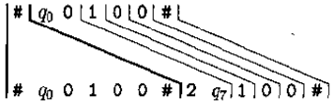
Part 4 places the dominos in P’.
Together with part 5, allow us to extend the match to

Slide 14

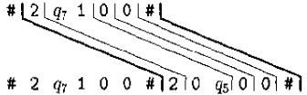
Example
Continuing the example, it’s in state q₇.
There is a transition δ(q₇,1)=(q₅,0,R). Then we have the domino The match extends to

Slide 15

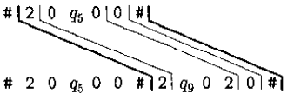
Cont.
We have transition δ(q₅,0)=(q₉,2,L). Then we have the dominos
The first one is relevant. The match extends to
The process continues until M reaches a halting state.

Slide 16

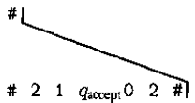
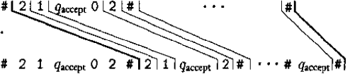
Part 6
This step adding “pseudo-step” after it has halted, where the head “eats” adjacent symbols until none are left.
We have . Extend the match to

Slide 17

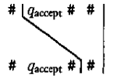
Part 7
Add the domino
and complete the match
That concludes the construction of P’.
P’ is an instance of MPCP whereby the match simulates the computation of M on w.
We need to convert P’ to P, an instance of the PCP that simulates M on w.

Slide 18
Convert
The idea is to build the requirement of starting with the first domino using some notation so that starting the explicit requirement is unnecessary.
Let u=u₁u₂…u_{n} be any string of length n. Define
  ★u=*u₁*u₂*…*u_{n}
  u ★ =u₁*u₂*…*u_{n}*
  ★u ★ =*u₁*u₂*…*u_{n}*

Slide 19




If P’ are the collection
Let P be the collection
Considering P as an instance of PCP, the starting domino must be .
The domino is added to the end of the match to balance number of *.

Slide 20
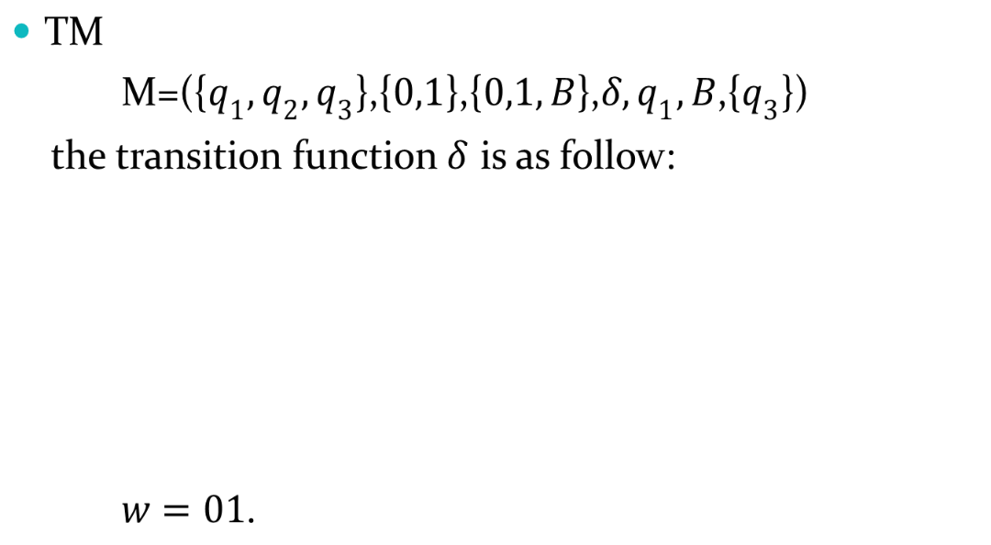
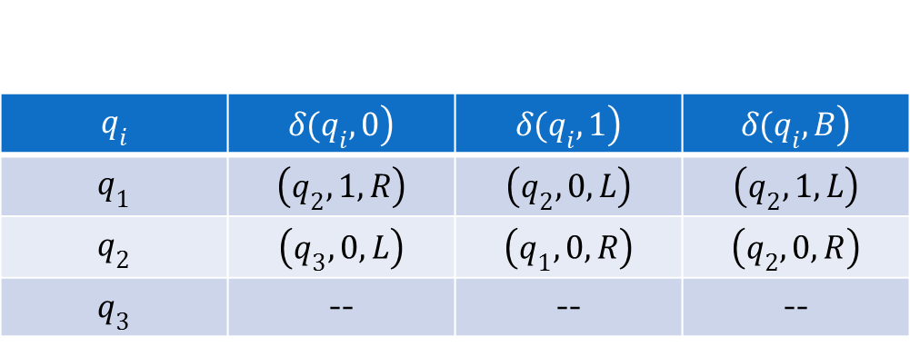
Example
 | -- | -- | --

Slide 21
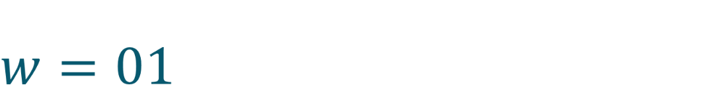
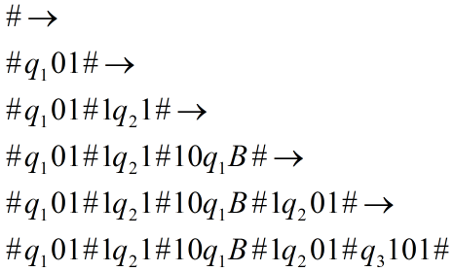
We simulate Turing Machine M, the computation history is:
Then M accept w.

Slide 22
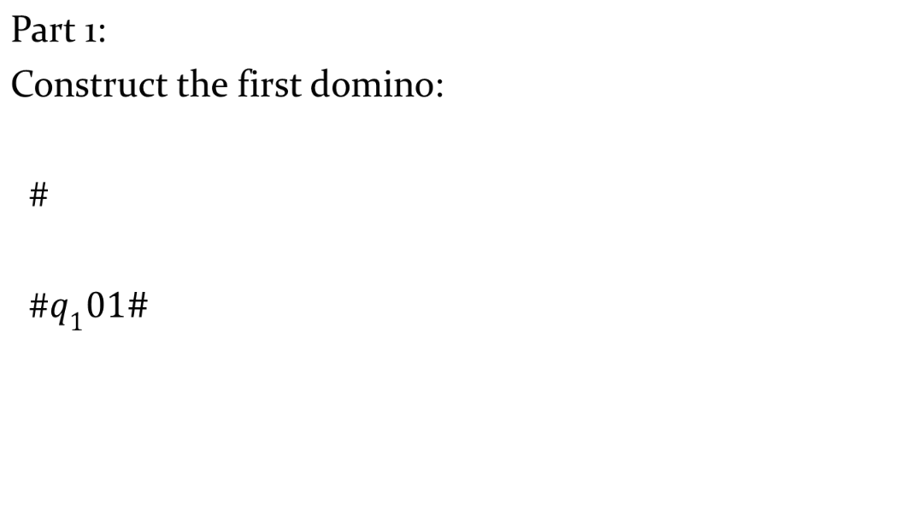
Example — MPCP

Slide 23
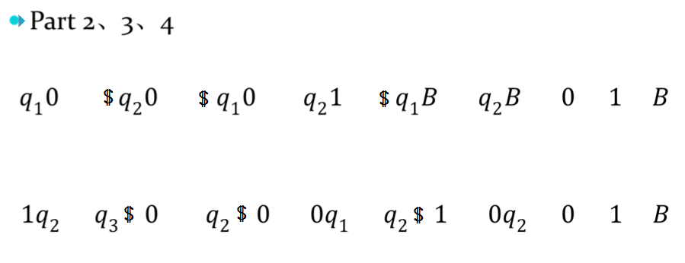
Example — MPCP
 | -- | -- | --
Here $ can be 0|1|B

Slide 24
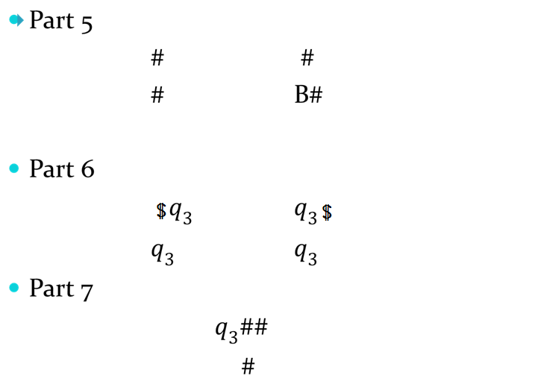
Example — MPCP
We have got all
the dominos.

Slide 25
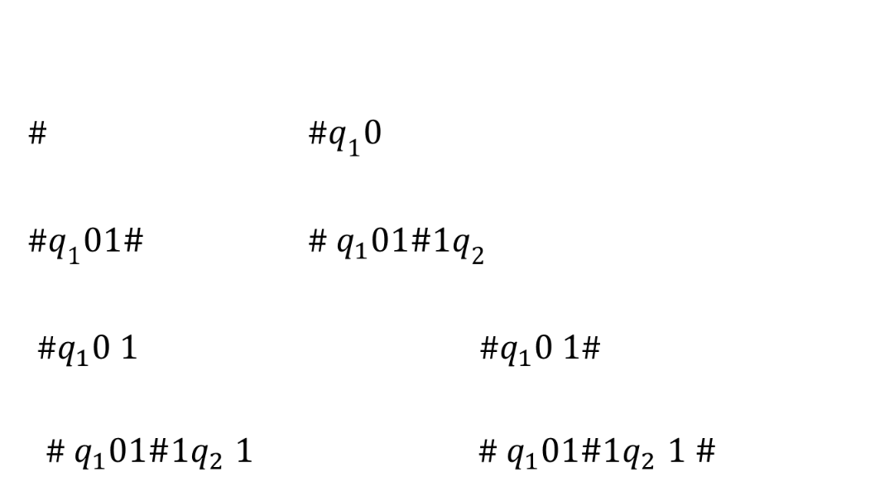
Example — MPCP
Then we begin to simulate the MPCP:

Slide 26
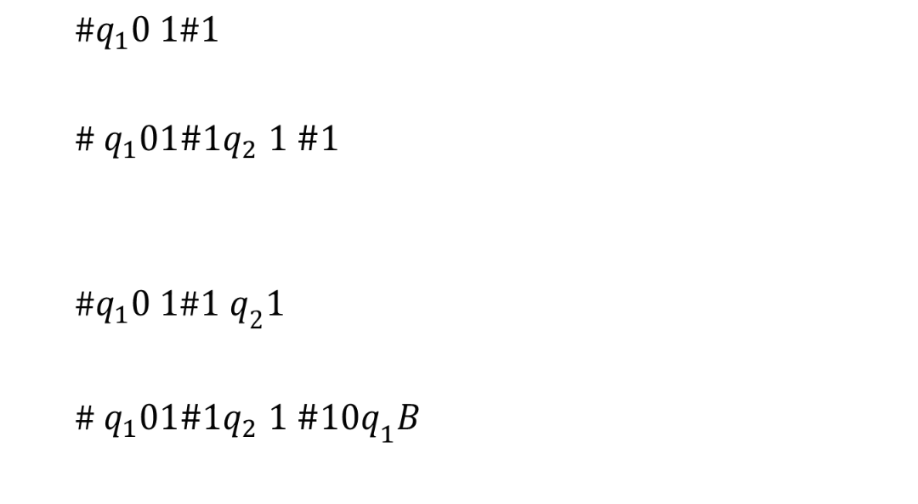
Example — MPCP

Slide 27
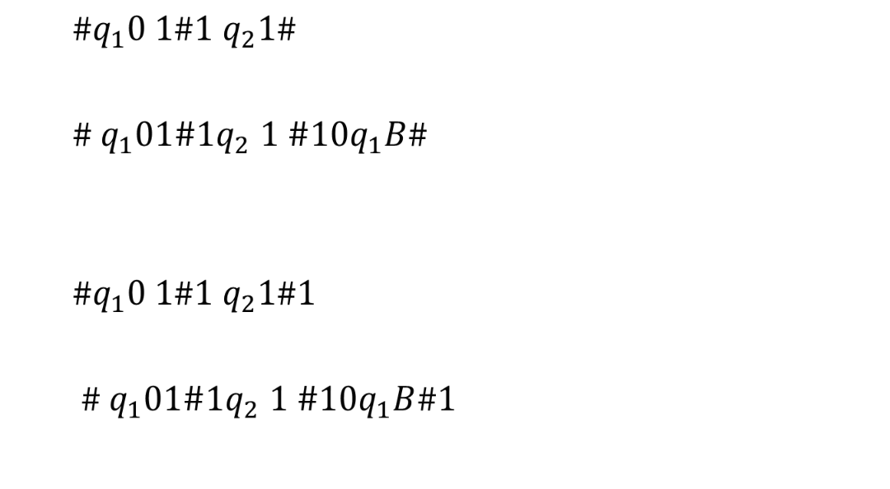
Example — MPCP

Slide 28
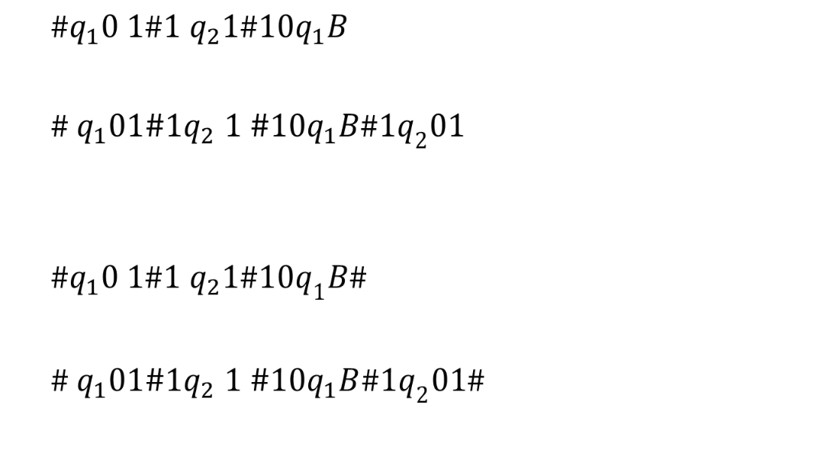
Example — MPCP

Slide 29
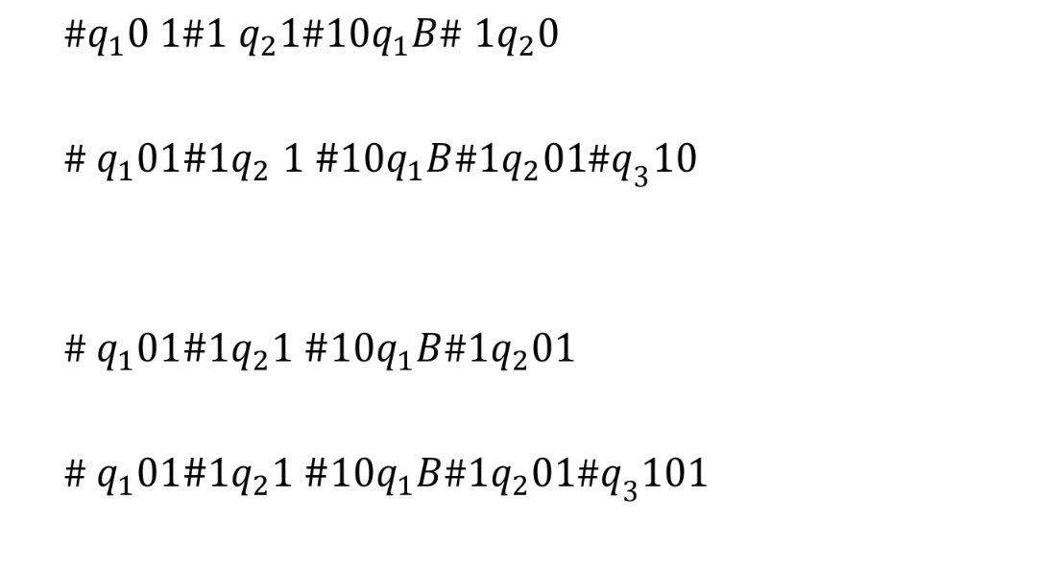
Example — MPCP

Slide 30
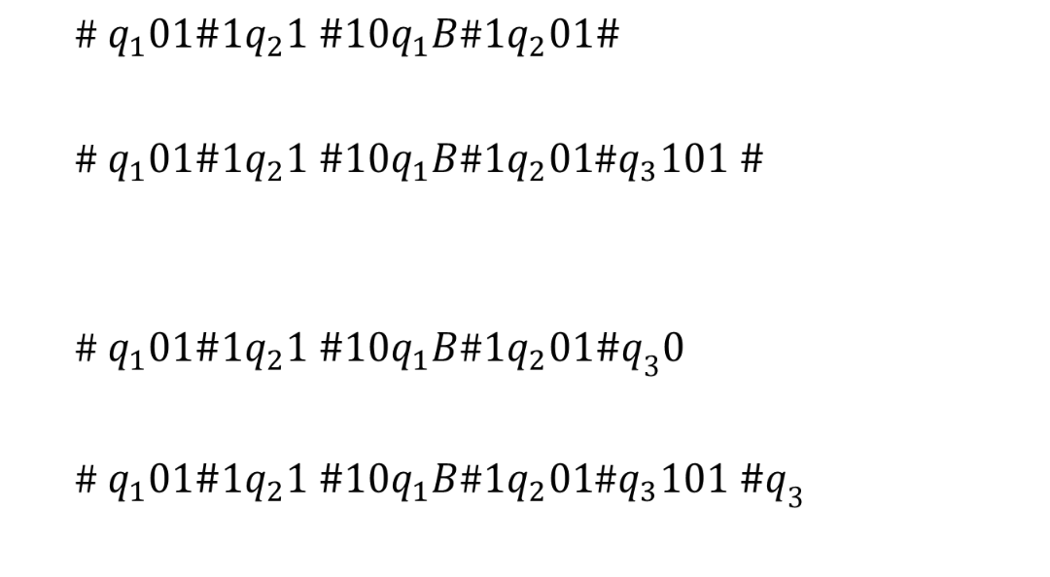
Example — MPCP

Slide 31
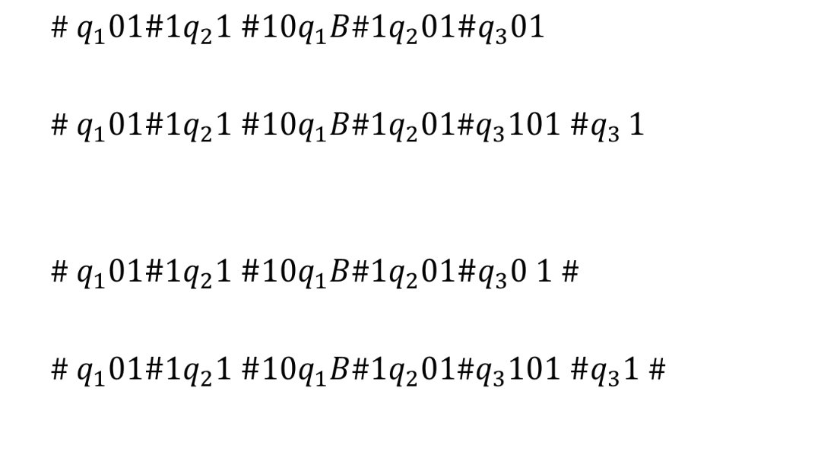
Example — MPCP

Slide 32
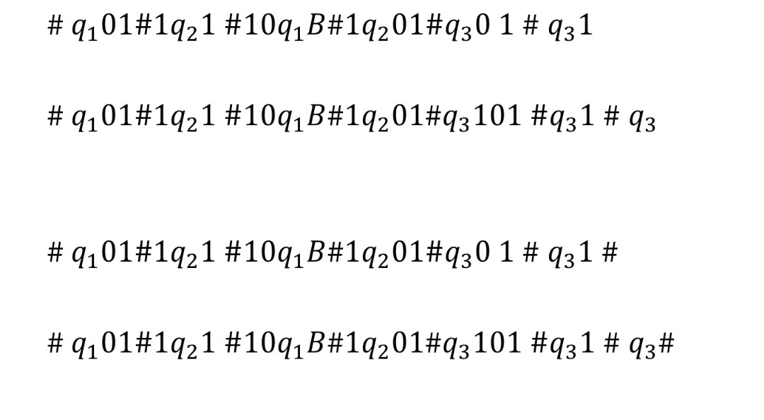
Example — MPCP

Slide 33
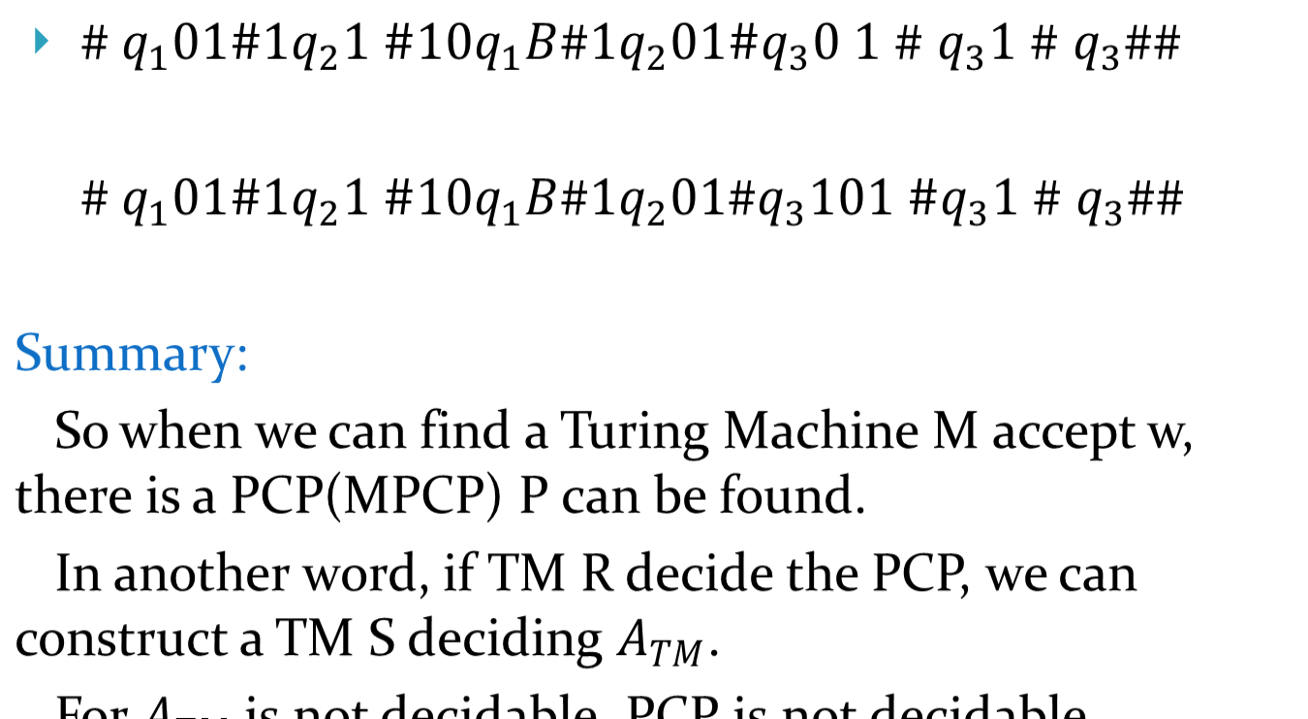
Example — MPCP
Done!

